Slide 1
Prototype #2 Meeting
Attendees: Dr. Kristin Stewart, Dr. Shaunn-inn Wu, Stoic Solutions Team

Slide 2
Recap and Current Requirements
Goal of prototype 1 was to find a way to gather images from Google Street View within the city of San Marcos.
Subtask: Create a database (Pushed to prototype 2)
Goal of prototype 2 was to process all the gathered images through the machine learning algorithm.
Subtask: Create a database for storage of data.
The remaining requirements are to refine the raw data so that it can be put into our database for the UI group to access and display.
UI Team was given access to database with a temporary set of test data.

Slide 3
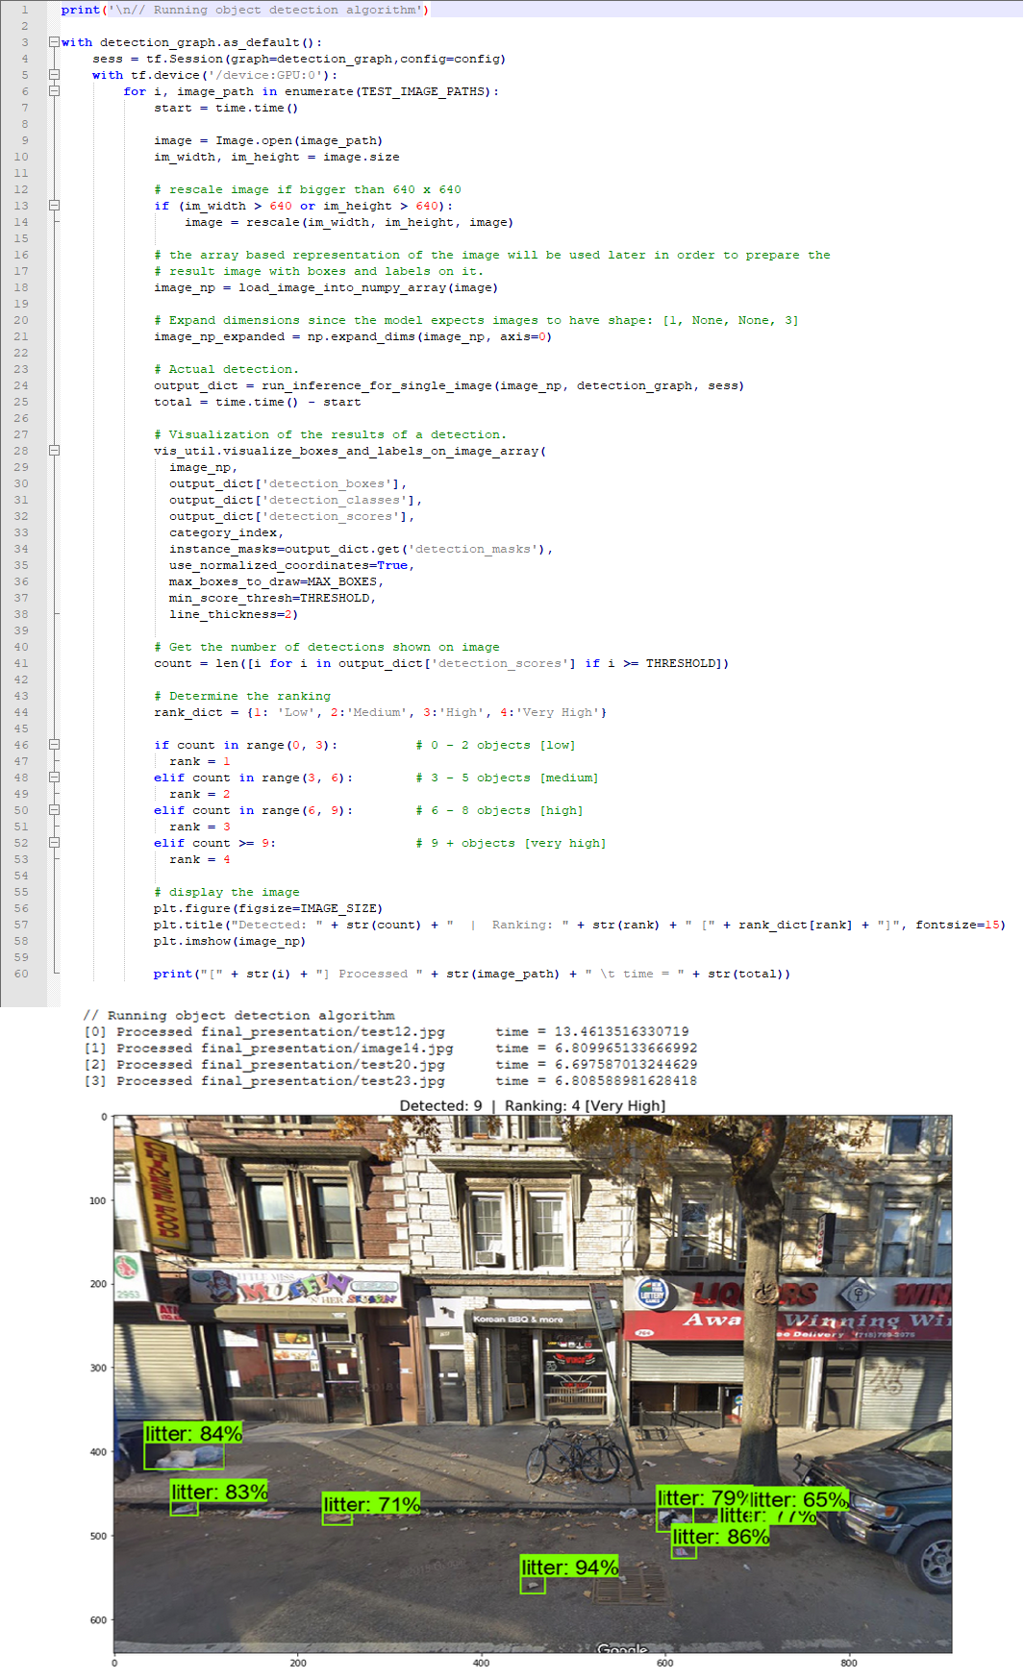
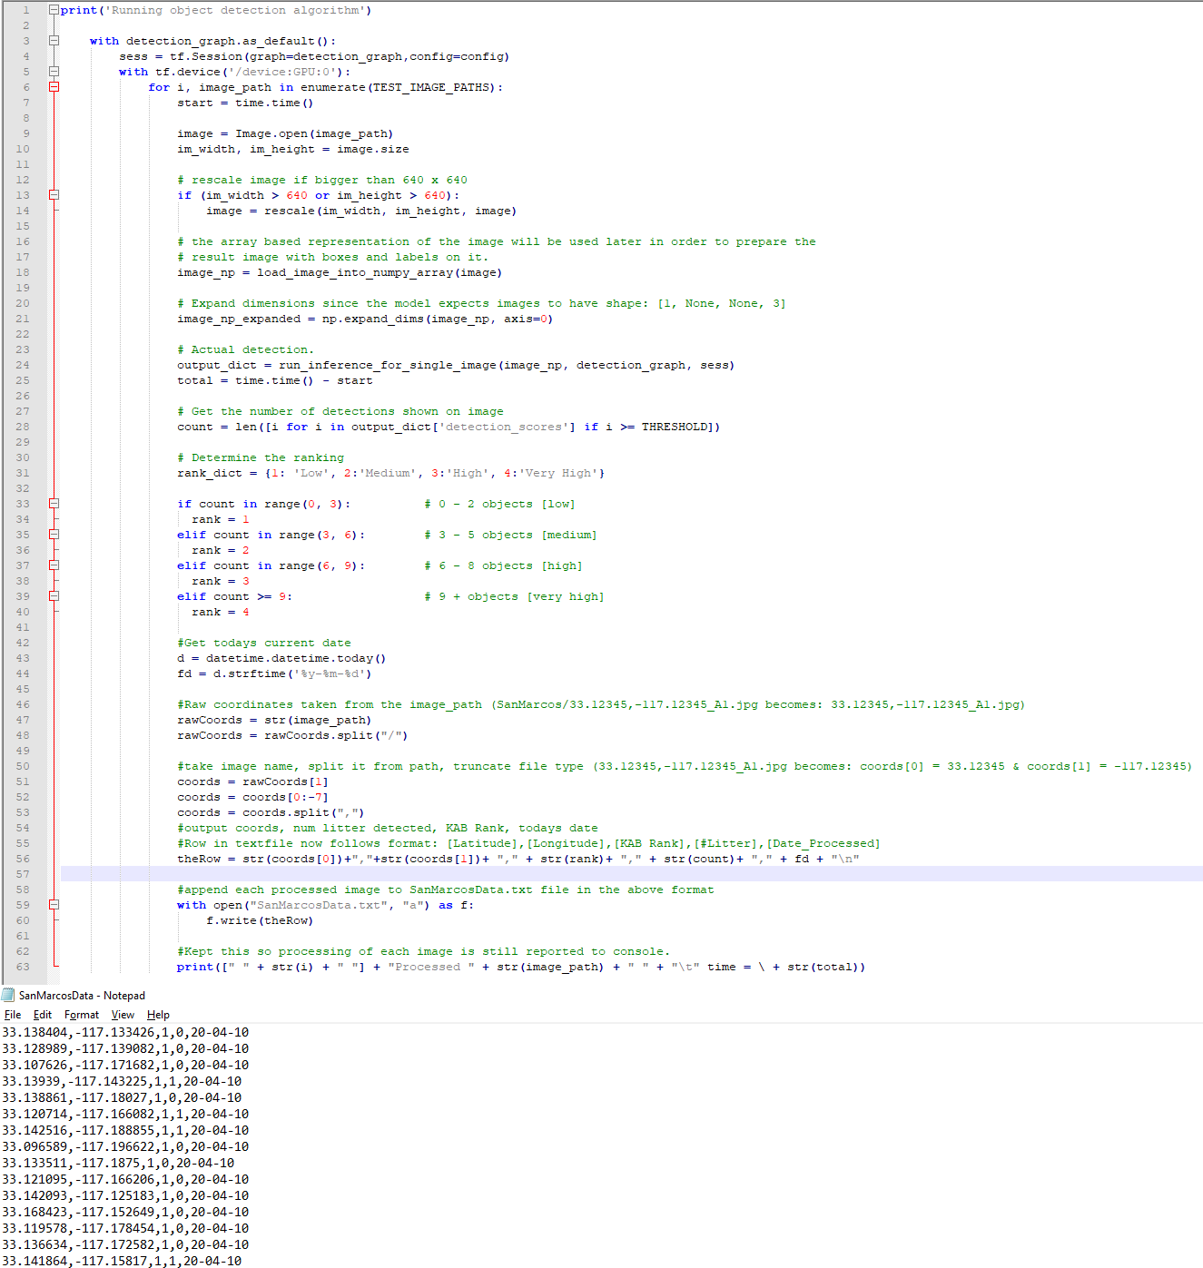
Script Modifications
fixIT Script
Stoic Solutions Script
fixIT Script was modified to produce processed data in the format that our database could use.

Slide 4
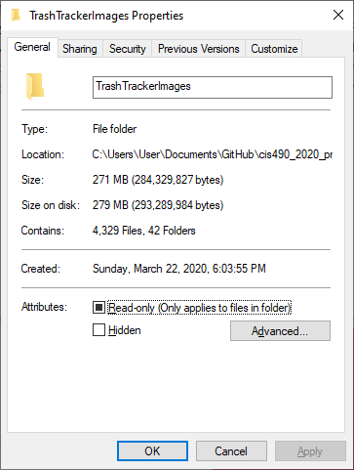
Image Uploading and Processing
4,329 images gathered from streets of San Marcos.
Some were duplicates or were not valid images which left us with 4,216 unique and valid images.
2,108 unique coordinates with two angles each.
Each image takes ~6 seconds to process.
4,216 * 6s = 25,296s
25,296s = 7.03 hours

Slide 5
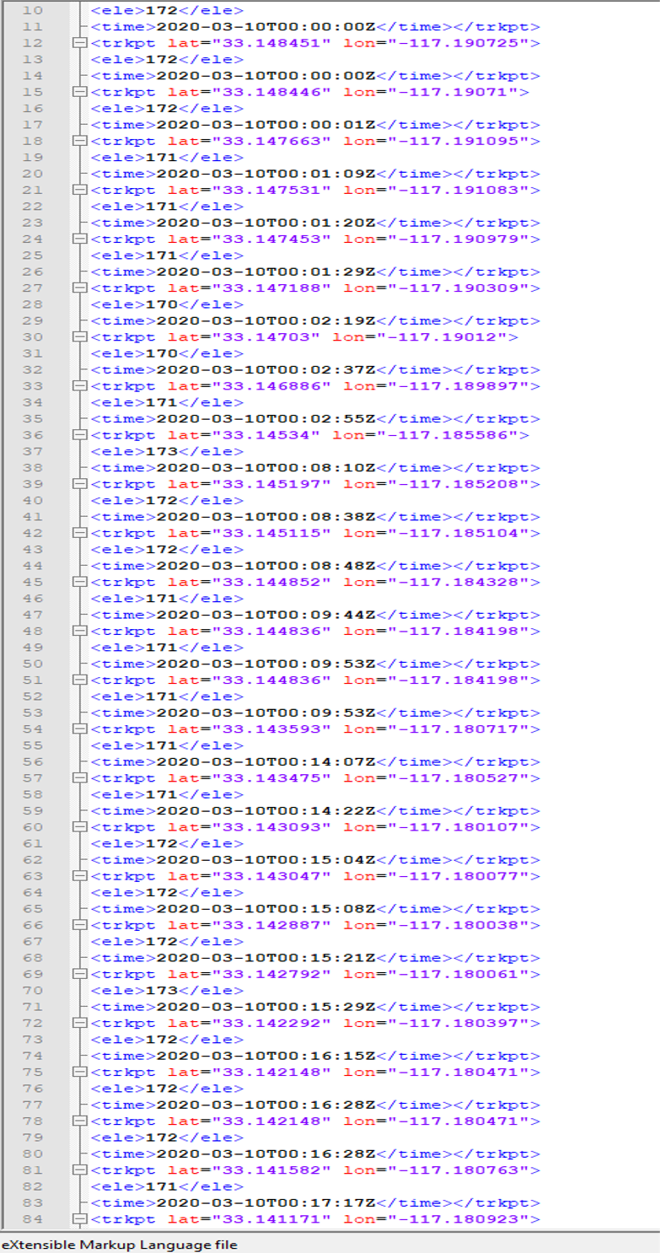
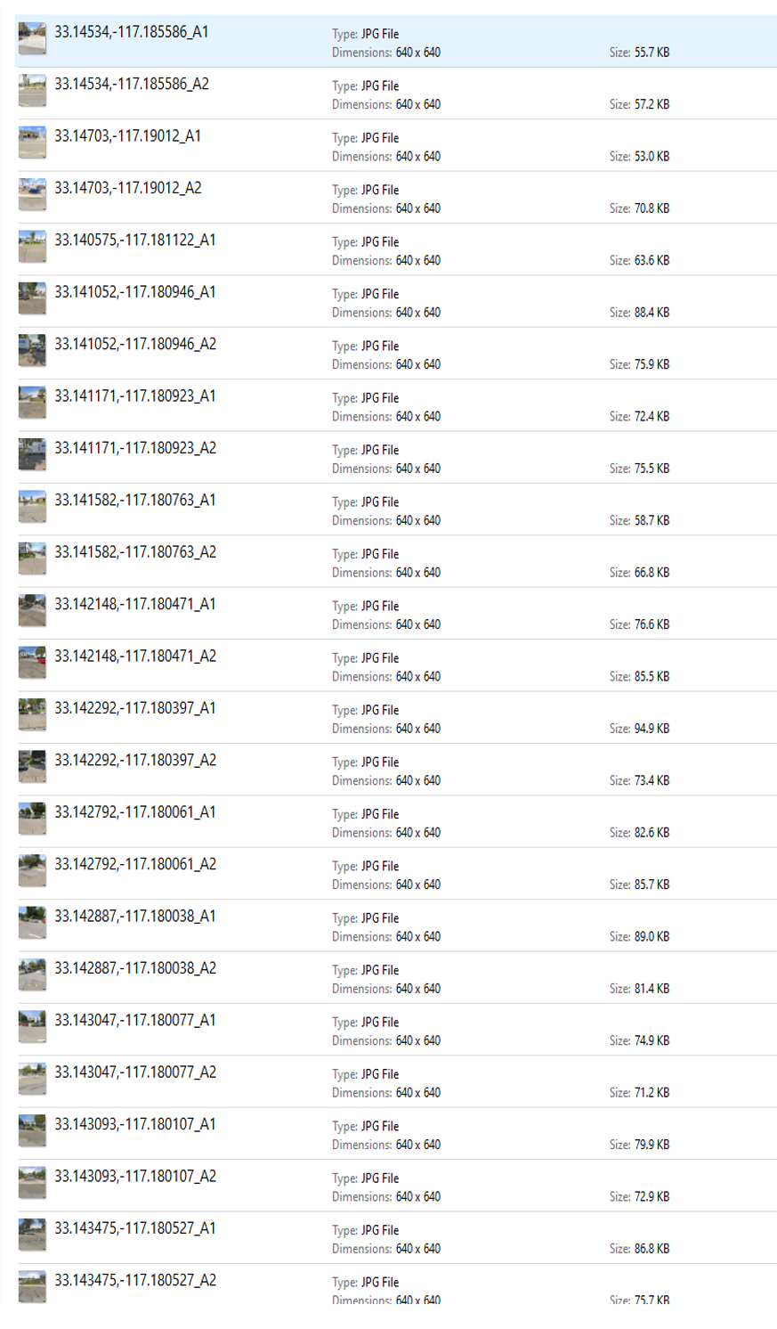
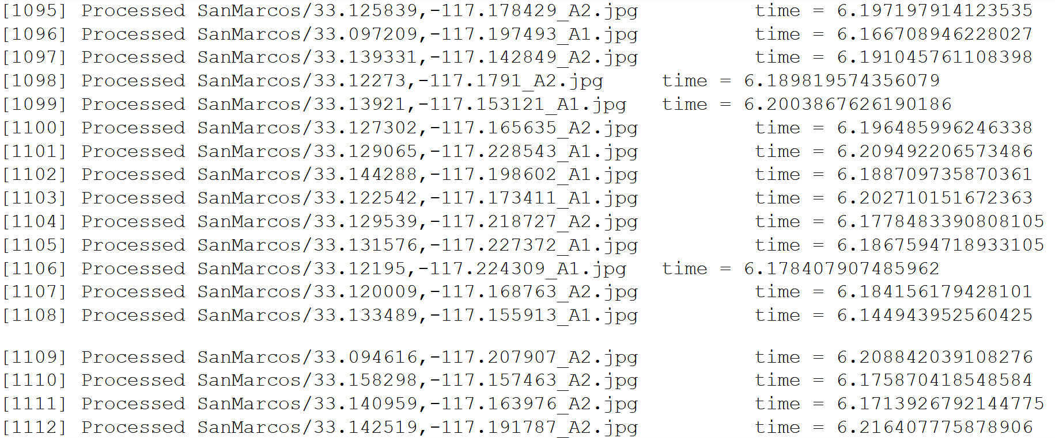
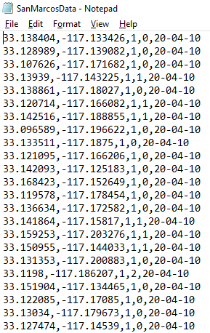
Process from GPX to Database Rows
GPX File
Images
ML Processing
Raw Data

Slide 6
New and Final Python Script Purpose
Parse the text file to push the appropriate data into the database
Calculating combined [LAT][LON]_A1 & [LAT][LON]_A2:
(Angle1_#LitterPieces + Angle2_#LitterPieces) / 2 = Avg #LitterPieces PER Coordinate
How KAB Litter ranks are determined:
1 = 0-2 (Avg Pieces of litter)
2 = 3-5 (Avg Pieces of litter)
3 = 6-8 (Avg Pieces of litter)
4 = 9+ (Avg Pieces of litter)
Example:
[Angle1] : 33.159253,-117.203276,1,1,20-04-10
[Angle2] : 33.159253,-117.203276,2,3,20-04-10
[33.159253,-117.203276]: 1 + 3 = 4/2 = 2
KAB Rank = 1

Slide 7
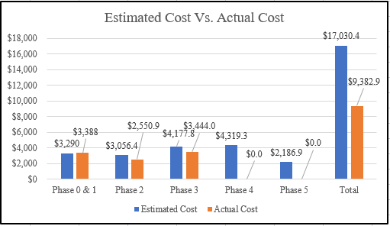
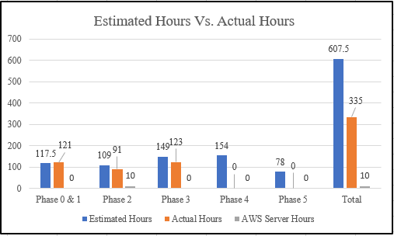
Project Management

Slide 8
Documentation Details
Storing all our files, manuals, and documents on GitHub.
Also storing some of the past groups files that we used.
Storing it on GitHub allows any future groups to view and download our project.
Provides long-term storage and documentation.
Allows us to communicate our struggles, possible ways to address future requirements, and advice.
https://github.com/stoicSolutions/cis490_2020_project

Slide 9
Database cost and whereabouts
AWS Free Tier Relational Database (t2.micro).
Free for 750 hours in the first 12 months.
We will provide the raw data file, as well as attempt to export our database image.
This will allow any future group to easily import the database if they should need to.
However, the AWS account will be shut down at the end of the semester to avoid unnecessary costs.
The UI group has been given access to our database.
Here are the details just for posterity:
Endpoint:Port :Trashtrackerdb.cth19jrs3gyq.us-west-2.rds.amazonaws.com:3306
DBName: innodb
Username: trashtrackerAdm, Password: StoIcC0ugars
DB Instance ID: trashtrackerdb

Slide 10
Database Details
Rows follow the format:
There should be approximately 2,108 rows of data.
These represent each pair of coordinates and their data after being processed by the machine learning algorithm and refined by another python script.
Unique ID # | Latitude | Longitude | KAB Ranking | # of Litter Detected | Date Processed

